Slide 1
Basketball League Prediction
Connor Greenhalgh

Slide 2
Research Question
Which basketball league is the best fit for prospective professional basketball players?

Slide 3
Context

Slide 4
Basketball is still growing
NBA is an icon for many kids around the world
Basketball is top 10 sport globally ahead of baseball and golf
Basketball is a career for many people and it’s more than just a sport for them
Players and organizations want to find the best fit
Hopefully analyzing professional basketball data will allow professional players more insight on where they would be the most valued

Slide 5
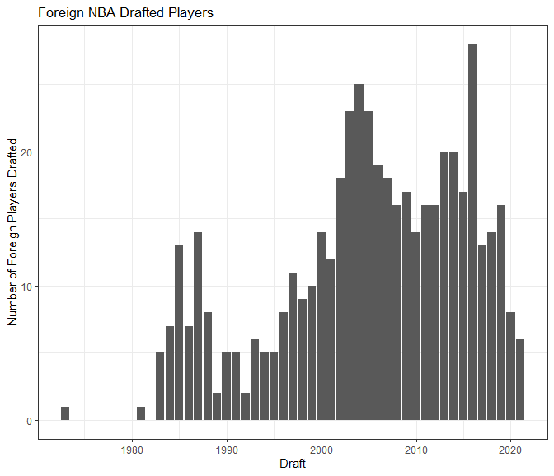
NBA has more foreign players than ever
This season includes 109 international players from 39 countries
There’s been an increase in foreign NBA drafted players
The drop in very recent years due to stronger international leagues

Slide 6
DATA Collection

Slide 7
Web Scraping
Use basketball-reference.com to scrape data from
  NBA
  G-League
  International Leagues
Used per 36 minutes data
Included basic basketball statistics also height, weight, and college
Used data since the 2016-2017 season

Slide 8










International Leagues Included
Notes:
Liga ACB, LNB Pro A(French), Lega Serie A(Italy), Greek Basket League, Israeli Super League, Turkish Super League, ABA Adriatic, VTB United(Russia), NBL Australia, CBA China

Slide 9
Data Cleaning
Before training a model some light cleaning needed to be made
  Removed any players with all NAs or very few minutes
  Replace percentage variables NAs with zeroes
  Clean other names for certain schools (Utah St and Utah St University)
  What to do with players who attended multiple colleges
  Some schools only had very few professional basketball players

Slide 10
DATA modeling

Slide 11
Train/Test Split & Preprocessing
Used a 90/10 ratio for a train test split
Preprocessing
  Checked for multicollinearity
  Centered and scaled the numerical data
  Created dummy variables for conference

Slide 12
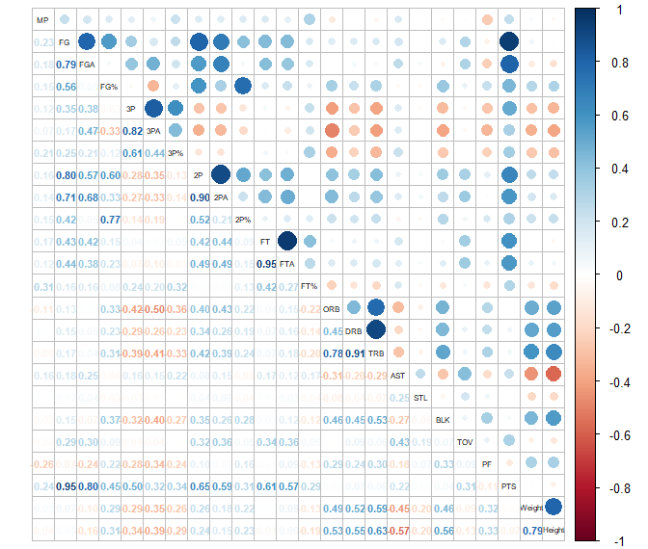
Correlation Matrix
Pretty much very intuitive, obvious correlated variables

Slide 13
Types of Models
Random Forest
K-Nearest Neighbors
Naïve Bayes
All models’ best tune was between a 60-70% accuracy

Slide 14
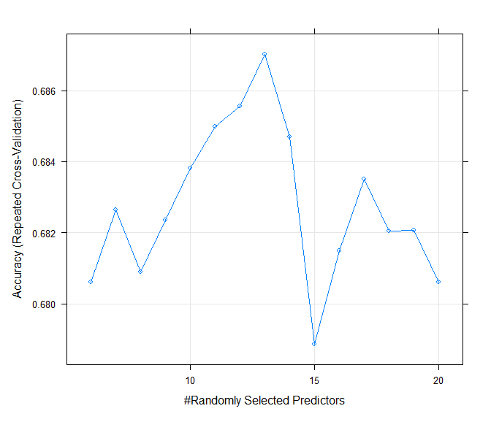
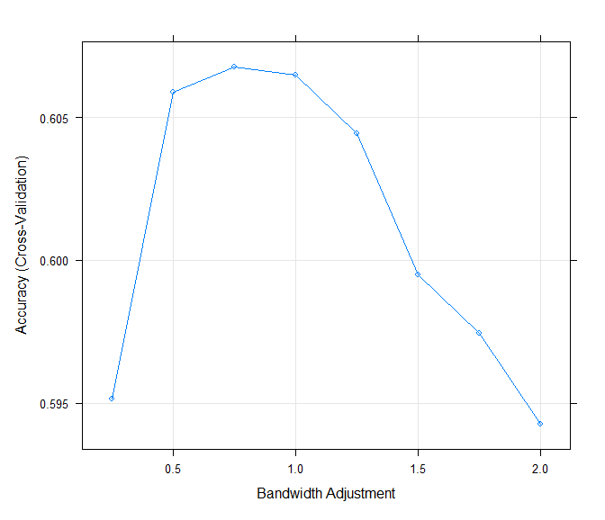
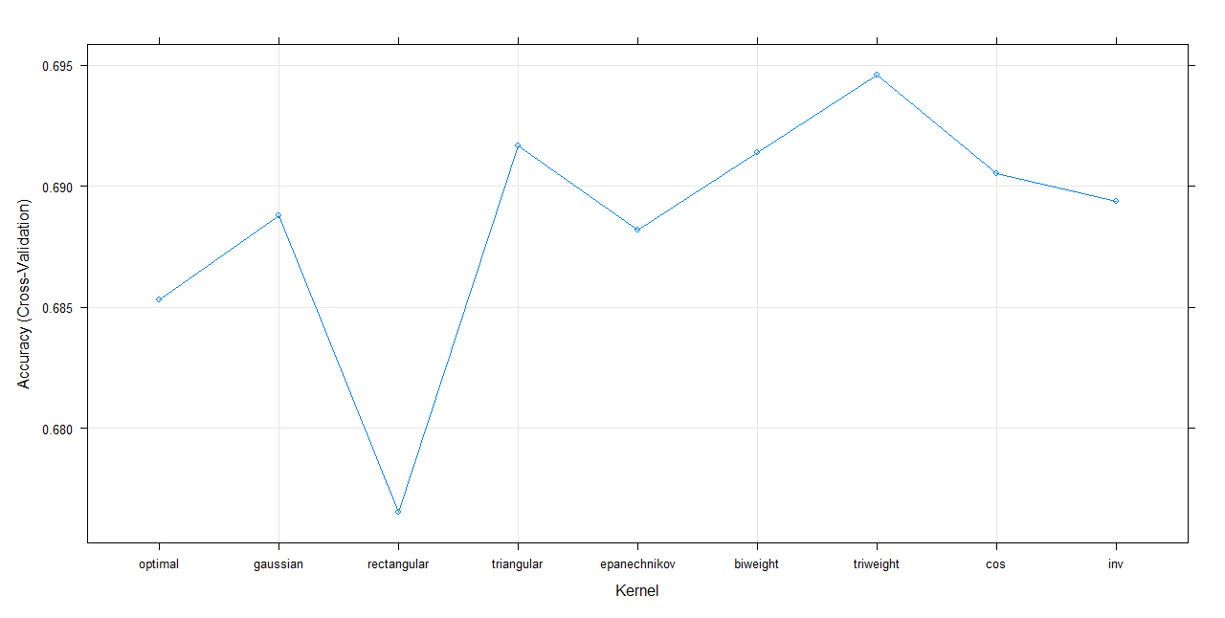

Slide 15
REsults

Slide 16
Accuracy
The Random Forest and K-Nearest Neighbors models had similar accuracies
  Overall accuracy of 70%
So is there a better model?
  Check each model’s accuracy within league

Slide 17
KNN Random Forest
League | Accuracy | Count
ABA Adriatic | 0.0000000 | 1
CBA China | 0.8333333 | 6
G-League | 0.5094340 | 106
Greek Basket League | 0.1666667 | 6
Lega Serie A | 0.4545455 | 11
Liga ACB | 0.2500000 | 4
LNB Pro A | 0.2222222 | 9
NBA | 0.8652174 | 230
NBL Australia | 0.1666667 | 6
Turkish Super League | 0.0000000 | 1
VTB United | 0.0000000 | 2
League | Accuracy | Count
ABA Adriatic | 0.00000000 | 1
CBA China | 0.50000000 | 6
G-League | 0.49056604 | 106
Greek Basket League | 0.00000000 | 6
Lega Serie A | 0.09090909 | 11
Liga ACB | 0.25000000 | 4
LNB Pro A | 0.00000000 | 9
NBA | 0.92608696 | 230
NBL Australia | 0.00000000 | 6
Turkish Super League | 0.00000000 | 1
VTB United | 0.00000000 | 2

Slide 18
What happens if NBA Players are Removed

Slide 19
Variable Importance
TOV | 100.0000000
FGA | 72.6966133
Weight | 72.3872855
`2P%` | 68.5920333
AST | 67.7380963
FT | 59.8943713
BLK | 54.5043616
`3P%` | 53.2553209
`FT%` | 52.5915468
`2PA` | 51.6475568
FGA | 100.0000000
FTA | 89.8925377
Weight | 75.2071728
BLK | 72.7120906
AST | 66.6845982
DRB | 61.1432105
`2P%` | 59.1334390
PF | 55.5832413
`FT%` | 54.1559102
`3P%` | 52.4022728

Slide 20
Variable Importance
Conf_Other | 11.9927807
Conf_BIG10 | 4.4876473
Conf_BIG_EAST | 2.4550232
Conf_ACC | 2.3792072
Conf_SEC | 2.0552330
Conf_American | 1.9457725
Conf_PAC12 | 0.8101267
Conf_A10 | 0.5364812
Conf_WCC | 0.3792975
Conf_MW | 0.2977521
Conf_BIG12 | 0.0000000
Conf_ACC | 8.3913243
Conf_American | 5.5894468
Conf_Other | 5.4620492
Conf_BIG10 | 5.1144912
Conf_BIG_EAST | 4.6057782
Conf_WCC | 3.8613676
Conf_SEC | 3.0728863
Conf_A10 | 1.7197674
Conf_PAC12 | 1.3209342
Conf_BIG12 | 0.3638791
Conf_MW | 0.0000000

Slide 21
What’s nExt

Slide 22
Implementation
Collect data for NCAA D1 players
Predict league and probability assignments for each league
Helpful for players and organizations
  Players’ careers
  Organizations’ successes
  Draft & Free Agency

Slide 23
Limitations
Wanted to keep it recent but not many leagues had previous NCAA D1 basketball players
  Many leagues had fewer than 20 players who played NCAA D1 in the past 5 seasons
Options include
  Use more years as data
  Remove uncommon leagues

Slide 24
Changes to Model
Gather more statistics
  Are there more identifiable metrics
EuroLeague and EuroCup distinguisher
Predict player type
  Star in one league v role player in a different league

Slide 25
References
https://www.nba.com/news/nba-rosters-feature-109-international-player

